Slide 1

Introduction to Operating Systems CS/COE 1550
Spring 2020-2021
Sherif Khattab
ksm73@pitt.edu
(Some slides are from Silberschatz, Galvin and Gagne ©2013)

Slide 2
Announcements
Upcoming deadlines:
Project 1 and Homework 4: due on 2/19
Tophat questions due one week after each lecture
Three free extension days for homework assignments and labs only.
Please make good use of the office hours of the entire teaching team. We are all here to help you.
Tophat grades on Canvas are not accurate
Last week's recitations are particularly useful for Project 1.
Applications for the 2021 virtual Randall Family Big Idea Competition are due Feb. 19 by 11:59 p.m.
Steelhacks (https://steelhacks.com/) is happening this Friday. Registration is still open.

Slide 3
Last Lecture …
Using Monitors to solve Classical Process Synchronization Problems
Bounded Buffer
Readers Writers
Dining Philosophers
Sleepy Barber

Slide 4
Muddiest Points (1/3)
HW
3: Q 11
4: Q 3,4,6,7,8
Monitor class attributes (why they are where they are)
Sleepy Barber
napInChair particularly
In the barber problem how exactly does the code work to check if the ticket equals the customers ticket since it is waiting while the number is greater than the customers ticket. Shouldn't waiting while the ticket number is less than theres? Basically just how does the customer know when it is there turn
Readers Writers Code
real-life applications of dining philosophers and sleepy barber. like in where would we run into these problems in industry?

Slide 5
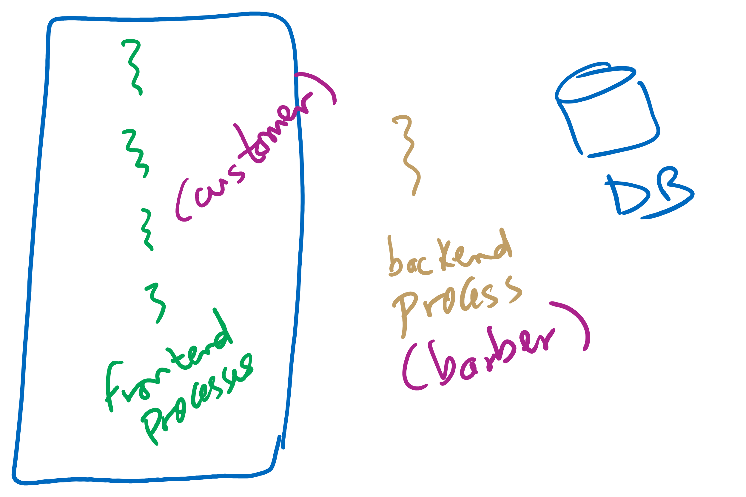
Sleepy Barber Real-life Example

Slide 6
Muddiest Points (2/3)
Which solution (semaphore or monitor-based) is the better solution for each problem?
what are the tradeoffs between using semaphores vs monitors/condition vars to solve the synchronization problem?
Condition variables vs. other methods of synchronization in implementation
how does the signal work for the dining philosophers problem? If the left philosopher signals but the right one does not, will the philosopher be able to eat when the right philosopher signals or will the signal from the left philosopher be lost?
How to check memory leak for project 1

Slide 7
Muddiest Points (3/3)
Midterm
could we assume the content of our homeworks will be similar to the questions?
Study guide
What will the format of the midterm be? Will we need to memorize the solutions to these famous problems?
When is our midterm?
How should we study for the midterm? Will there be a sample exam/questions released?

Slide 8
Today’s Agenda …
Using Monitors to solve Classical Process Synchronization Problems
Sleepy Barber
Deadlocks
Definition
Detecting Deadlocks

Slide 9
Monitor-based Solutions
Code Walkthrough at:
https://cs1550-2214.github.io/cs1550-code-handouts/ProcessSynchronization/Slides/

Slide 10
Deadlocks
Definition
Resource Allocation Graph
Why do deadlocks occur?
Dealing with deadlocks
Ignoring them: ostrich algorithm
Detecting & recovering from deadlock
Avoiding deadlock
Preventing deadlock

Slide 11
What is a deadlock?
Formal definition: “A set of processes is deadlocked if each process in the set is waiting for an event that only another process in the set can cause.”
Usually, the event is release of a currently held resource
In deadlock, none of the processes can
Run
Release resources
Be awakened

Slide 12
Four conditions for deadlock
Mutual exclusion
Each resource is assigned to at most one process
Hold and wait
A process holding resources can request more resources
No preemption
Previously granted resources cannot be forcibly taken away
Circular wait
There must be a circular chain of 2 or more processes where each is waiting for a resource held by the next member of the chain

Slide 13
Resource allocation graphs
Resource allocation modeled by directed graphs
Example 1:
Resource R assigned to process A
Example 2:
Process B is requesting / waiting for resource S
Example 3:
Process C holds T, waiting for U
Process D holds U, waiting for T
C and D are in deadlock!
A
R
B
S
T
C
D
U

Slide 14
Getting into deadlock
A
B
C
Acquire R
Acquire S
Release R
Release S
Acquire S
Acquire T
Release S
Release T
Acquire T
Acquire R
Release T
Release R
A
B
C
A
B
C
A
B
C
R
S
T
R
S
T
R
S
T
Acquire R
Acquire S
Acquire T
A
B
C
A
B
C
A
B
C
R
S
T
R
S
T
R
S
T
Deadlock!
Acquire S
Acquire T
Acquire R

Slide 15
Not getting into deadlock…
Many situations may result in deadlock (but don’t have to)
In previous example, A could release R before C requests R, resulting in no deadlock
Can we always get out of it this way?
Find ways to:
Detect deadlock and reverse it
Stop it from happening in the first place

Slide 16
The Ostrich Algorithm
Pretend there’s no problem
Reasonable if
Deadlocks occur very rarely
Cost of prevention is high
UNIX and Windows take this approach
Resources (memory, CPU, disk space) are plentiful
Deadlocks over such resources rarely occur
Deadlocks typically handled by rebooting
Trade off between convenience and correctness

Slide 17
Detecting deadlocks using graphs
Process holdings and requests in the table and in the graph (they’re equivalent)
Graph contains a cycle => deadlock!
Easy to pick out by looking at it (in this case)
Need to mechanically detect deadlock
Not all processes are deadlocked (A, C, F not in deadlock)
R
A
B
Process | Holds | Wants
A | R | S
B |  | T
C |  | S
D | U | S,T
E | T | V
F | W | S
G | V | U
C
S
D
T
E
F
U
V
W
G

Slide 18
Deadlock detection algorithm
General idea: try to find cycles in the resource allocation graph
Algorithm: depth-first search at each node
Mark arcs as they’re traversed
Build list of visited nodes
If node to be added is already on the list, a cycle exists!
Cycle == deadlock
Assuming one instance of each resource type
For each node N in the graph {
Set L = empty list
unmark all arcs
Traverse (N,L)
}
If no deadlock reported by now, there isn’t any
define Traverse (C,L) {
If C in L, report deadlock!
Add C to L
For each unmarked arc from C {
Mark the arc
Set A = arc destination
/* NOTE: L is a
local variable */
Traverse (A,L)
}
}

Slide 19
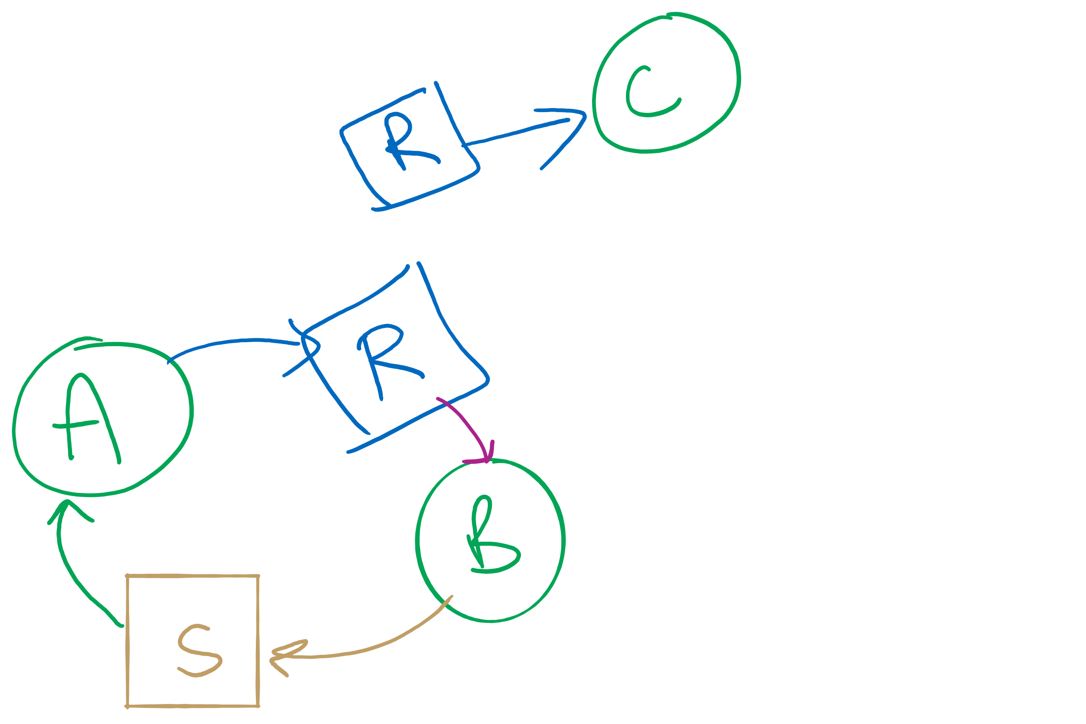
Resources with multiple instances
Previous algorithm only works if there’s one instance of each resource
If there are multiple instances of each resource, we need a different method
Track current usage and requests for each process
To detect deadlock, try to find a scenario where all processes can finish
If no such scenario exists, we have deadlock

Slide 20
Deadlock detection algorithm
 | A | B | C | D
Avail | 2 | 3 | 0 | 1
current=avail;
for (j = 0; j < N; j++) {
for (k=0; k<N; k++) {
if (finished[k])
continue;
if (want[k] <= current) {
finished[k] = 1;
current += hold[k];
break;
}
}
if (k==N) { //reached end of loop
printf “Deadlock!\n”;
// finished[k]==0 means process is in
// the deadlock
break;
}
}
Process | A | B | C | D
1 | 0 | 3 | 0 | 0
2 | 1 | 0 | 1 | 1
3 | 0 | 2 | 1 | 0
4 | 2 | 2 | 3 | 0
Hold
Process | A | B | C | D
1 | 3 | 2 | 1 | 0
2 | 2 | 2 | 0 | 0
3 | 3 | 5 | 3 | 1
4 | 0 | 4 | 1 | 1
Want
Note: want[j], hold[j], current, avail are arrays!

